Slide 1
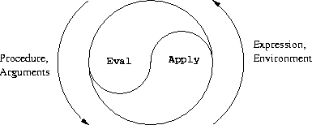
Computational Thinking & Systems Design Lecture 02: from Logic to Arithmetic
Ben Koo
September 22, 2020

Slide 2
Week 1 Review: Test Driven Design on Chips
Summary:
Test Driven Design: Logical correctness is verified through “Test Cases”.
There are many equivalent languages or models of computation(MoC) :
Truth Table、Logic Circuit、Hardware Description Language (HDL), …
Correspondence between MoC：Curry-Howard-Lambek Isomorphism
Complexity comes from composing simple things
There are total of 6 different 2 inputs/1 output logic gates (NAND/NOR …) that are considered to be “Universal Components”
You should be watching Nand2Tetris and Computational Structure’s first week video
Learn the whole stack by building a Blockchain-recorded Go game

Slide 3
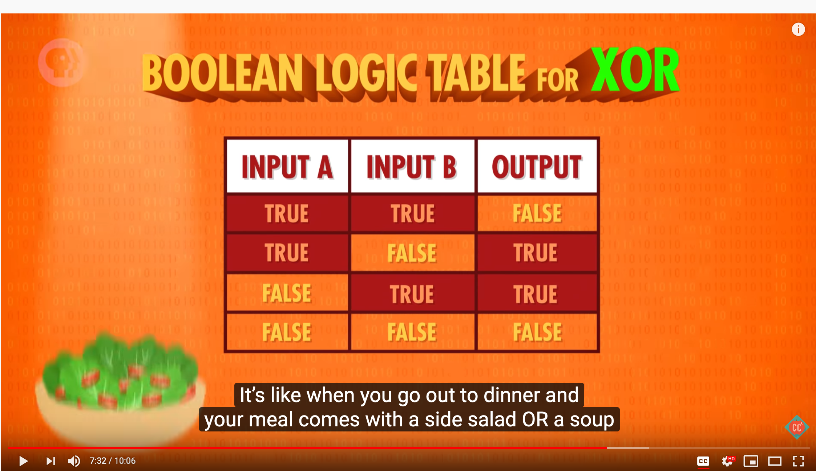
Week 1 References:
Videos:
Coursera Video website: https://www.coursera.org/learn/build-a-computer
Computer Science by PBS: https://youtu.be/gI-qXk7XojA
Boolean Logic & Logic Gates: Crash Course Computer Science #3

Slide 4
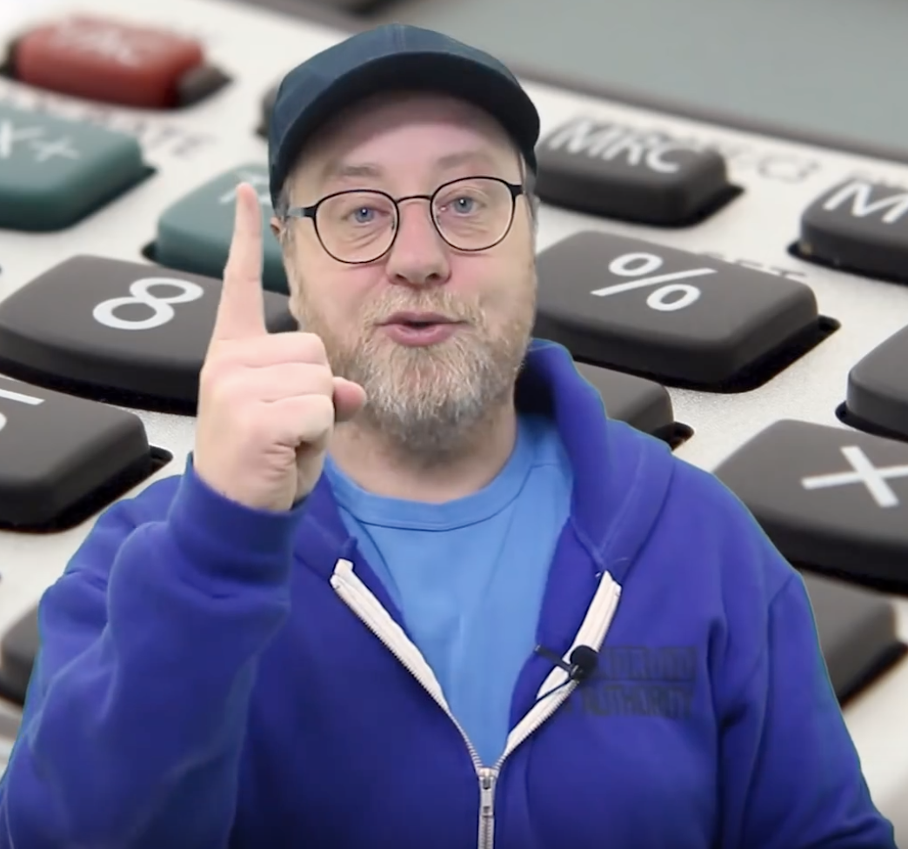
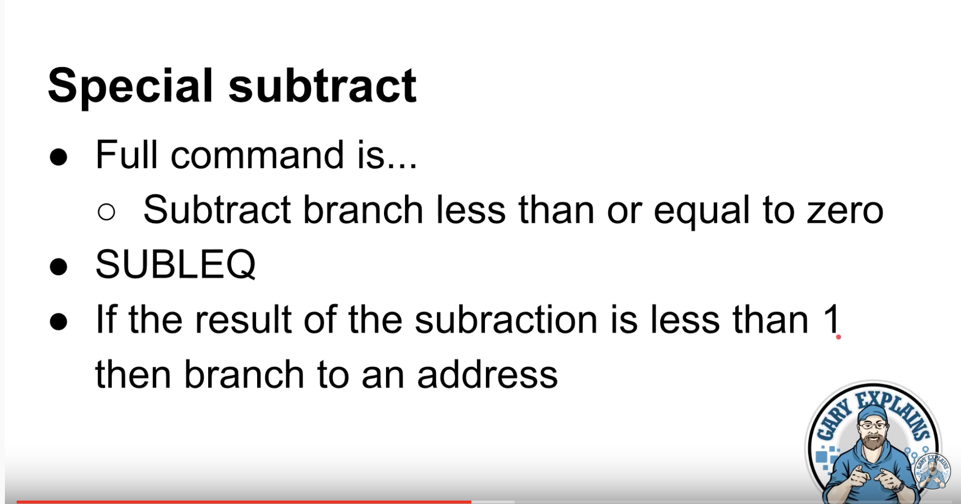
A CPU With Just One Instruction!!!
Gary Explains: https://youtu.be/jRZDnetjGuo

Slide 5
Languages ~= Models of Computation
The era of Super-Human Intelligence
The classification of intelligence is determined by the use of Languages
Formal Languages has computable objects: Vocabulary, Grammar, Semantics
From Logics to Number Systems: The Workhorse of Turing Complete Computation: Arithmetic Logic Unit
Memory: The Space-Time Entanglement of Digital Circuitry
Composition: The idea behind the assembly language
From Binary Notation to Human Mnemonics

Slide 6
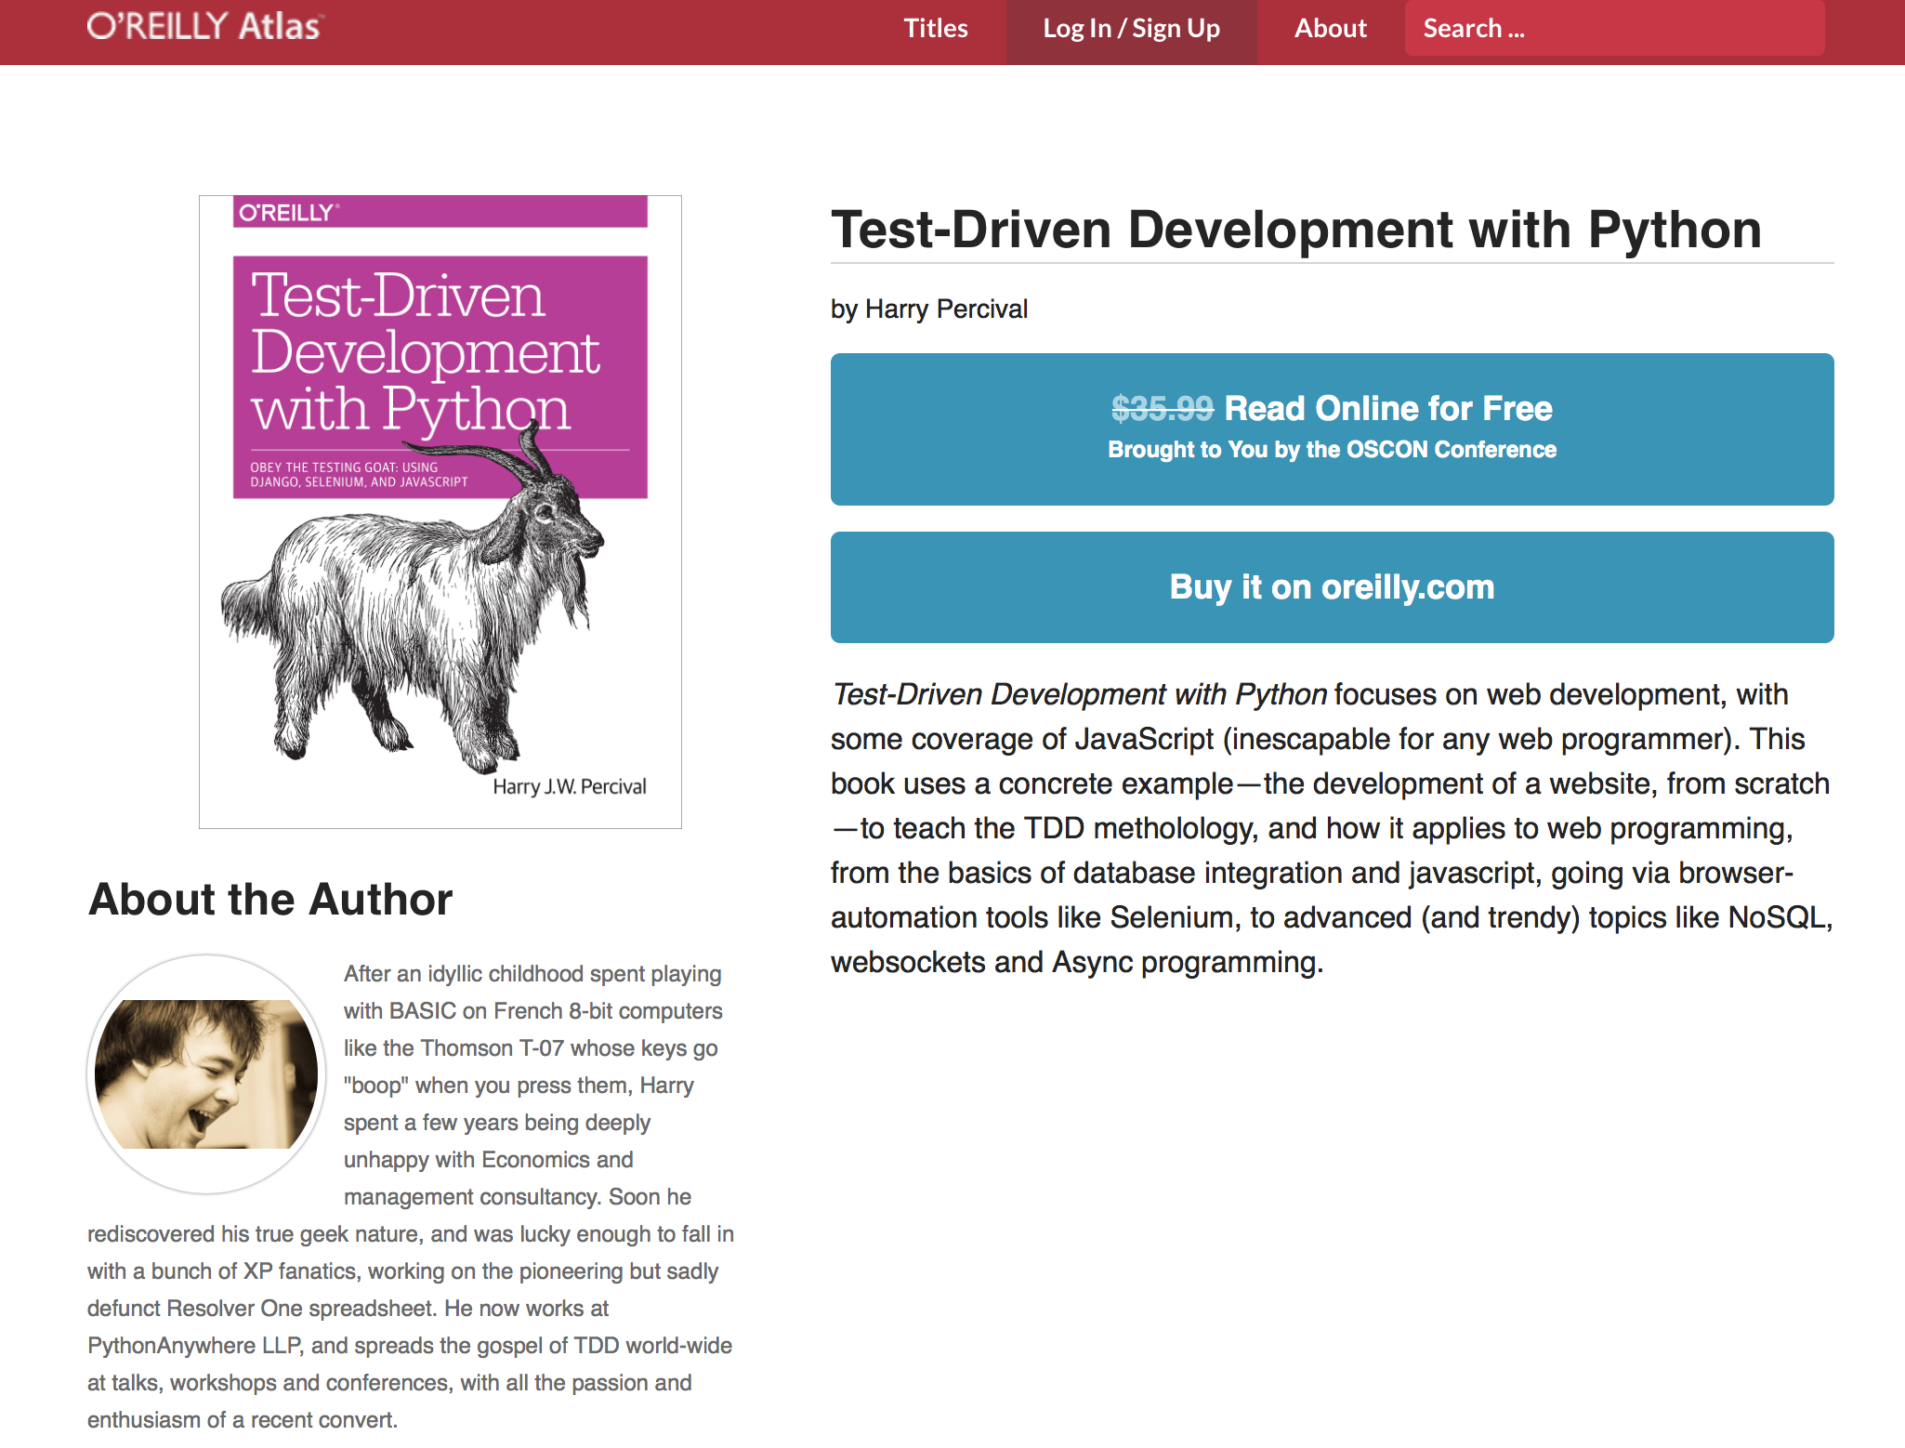

Tools and Books are freely available for building complex systems
http://chimera.labs.oreilly.com/books/1234000000754/index.html

Slide 7
Overview of the Nand2Tetris System
Hardware
Software
hierarchy
hierarchy
Human Machine Interfaces
Human
Physics
Operating System
Thought
Electrical Engineering
Layer 7
Compiler
Layer 1
Chips and Logic Gates
Systems Design
High Level Language
Chapter 13-15
Chapter 1-3
Layer 2
Layer 6
Chapter 10-11
Hardware Platform
VM Translator
User Defined Applications
Knowledge Representation
Logics and Arithmetic
Layer 3
Layer 5
Machine Language
Virtual Machine
Chapter 4-5
Chapter 9-12
Layer 4
Product/Service Design
Computer Architecture
Assembly Language
Chapter 6
Chapter 7-8

Slide 8
Operating System Maps to the other Layers
Human Machine Interfaces
Class Sys {
function void halt():
function void error(int errorCode)
function void wait(int duration)
}
Operating System
Layer 1
Layer 2
Layer 3
Layer 4
Layer 5
Layer 6
Layer 7
Chips and Logic Gates
Hardware Platform
Machine Language
Assembly Language
Virtual Machine
User Defined Applications
High Level Language
class Math {
function void init()
function int abs(int x)
function int multiply(int x, int y)
function int divide(int x, int y)
function int min(int x, int y)
function int max(int x, int y)
function int sqrt(int x)
}
Class Screen {
function void clearScreen()
function void setColor(boolean b)
function void drawPixel(int x, int y)
function void drawLine(int x1, int y1, int x2, int y2)
function void drawRectangle(int x1, int y1, int x2, int y2)
function void drawCircle(int x, int y, int r)
}
Class Array {
function Array new(int size)
method void dispose()
}
Class Keyboard {
function char keyPressed()
function char readChar()
function String readLine(String message)
function int readInt(String message)
}
Class String {
constructor String new(int maxLength)
method void dispose()
method int length()
method char charAt(int j)
method void setCharAt(int j, char c)
method String appendChar(char c)
method void eraseLastChar()
method int intValue()
method void setInt(int j)
function char backSpace()
function char doubleQuote()
function char newLine()
}
class Output {
function void moveCursor(int i, int j)
function void printChar(char c)
function void printString(String s)
function void printInt(int i)
function void println()
function void backSpace()
}
class Memory {
function int peek(int address)
function void poke(int address, int value)
function Array alloc(int size)
function void deAlloc(Array o)
}

Slide 9
Suggested Sequence to finish Operating System W12
Start familiarize yourself with the Jack Programming Language.
1. Use the “Sys” module to start learning the compiling and testing process of Week 12 assignment.
Class Sys {
function void halt():
function void error(int errorCode)
function void wait(int duration)
}
Human Machine Interfaces
Operating System
2. Finidng the most relevant module to implement as weeks go by. For example, for week 2, Math.jack
class Math {
function void init()
function int abs(int x)
function int multiply(int x, int y)
function int divide(int x, int y)
function int min(int x, int y)
function int max(int x, int y)
function int sqrt(int x)
}
Class Keyboard {
function char keyPressed()
function char readChar()
function String readLine(String message)
function int readInt(String message)
}

Slide 10
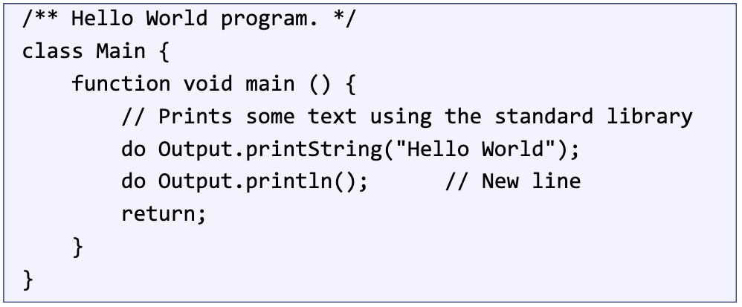
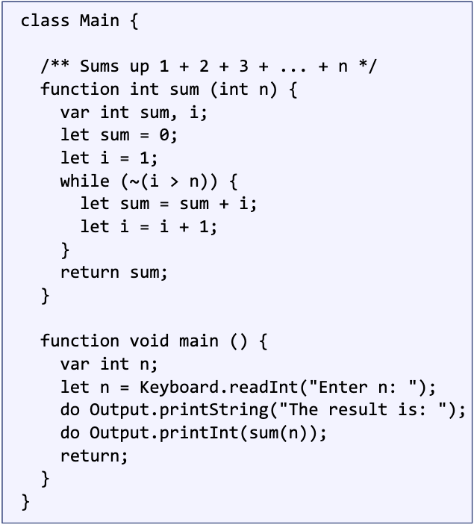
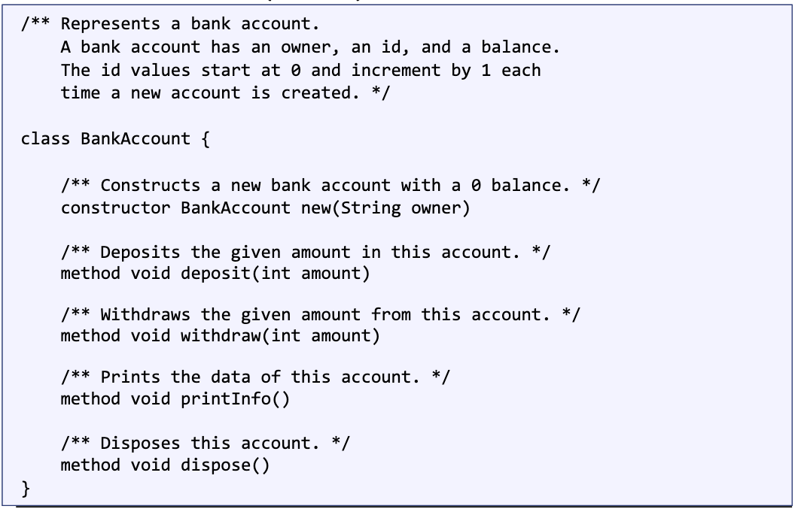
Some Code Examples

Slide 11
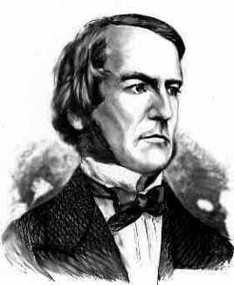
Boolean algebra
Given: Nand(a,b), false
We can build:
Not(a) = Nand(a,a)
true = Not(false)
And(a,b) = Not(Nand(a,b))
Or(a,b) = Not(And(Not(a),Not(b)))
Xor(a,b) = Or(And(a,Not(b)),And(Not(a),b)))
Etc.
George Boole, 1815-1864
(“A Calculus of Logic”)

Slide 12
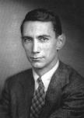
Gate logic
Interface
Claude Shannon, 1916-2001
(“Symbolic Analysis of Relay and Switching Circuits” )
Implementation
Xor(a,b) = Or(And(a,Not(b)),And(Not(a),b)))

Slide 13
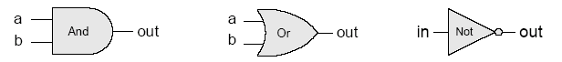
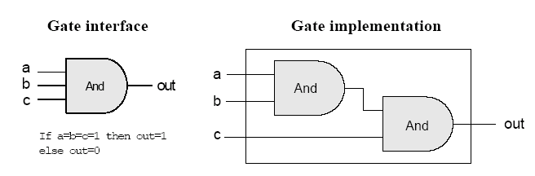
Gate logic
Gate logic – a gate architecture designed to implement a Boolean function
Elementary gates:
Composite gates:
Important distinction: Interface (what) VS implementation (how).

Slide 14
Multiplexer
a b sel out
0 0 0 0
0 0 1 0
0 1 0 0
0 1 1 1
1 0 0 1
1 0 1 0
1 1 0 1
1 1 1
sel out
0 a
1 b
Proposed Implementation: based on Not, And, Or gates.

Slide 15
Example: Building an And gate
Contract:
When running your .hdl on our .tst, your .out should be the same as our .cmp.
And.cmp
a b out
0 0 0
0 1 0
1 0 0
1 1 1
And.hdl
And.tst
CHIP And
{ IN a, b;
OUT out;
// implementation missing
}
load And.hdl,
output-file And.out,
compare-to And.cmp,
output-list a b out;
set a 0,set b 0,eval,output;
set a 0,set b 1,eval,output;
set a 1,set b 0,eval,output;
set a 1, set b 1, eval, output;

Slide 16
Building an And gate
Interface: And(a,b) = 1 exactly when a=b=1
And.hdl
CHIP And
{ IN a, b;
OUT out;
// implementation missing
}

Slide 17

Building an And gate
Implementation: And(a,b) = Not(Nand(a,b))
And.hdl
CHIP And
{ IN a, b;
OUT out;
// implementation missing
}

Slide 18
Building an And gate
Implementation: And(a,b) = Not(Nand(a,b))
And.hdl
CHIP And
{ IN a, b;
OUT out;
// implementation missing
}

Slide 19
Building an And gate
Implementation: And(a,b) = Not(Nand(a,b))
And.hdl
CHIP And
{ IN a, b;
OUT out;
Nand(a = a, b = b, out = x);
Not(in = x, out = out)
}

Slide 20
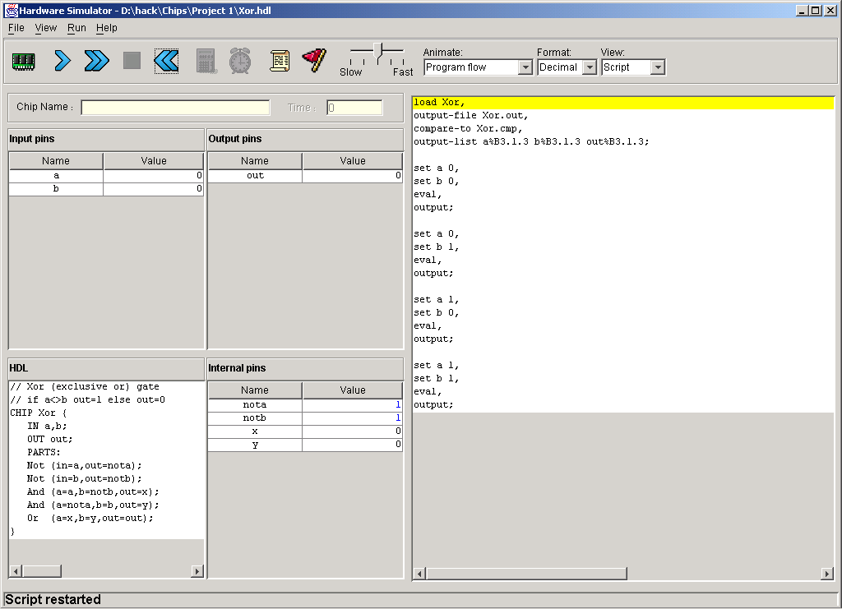
Hardware simulator (demonstrating Xor gate construction)
HDL program
test script

Slide 21
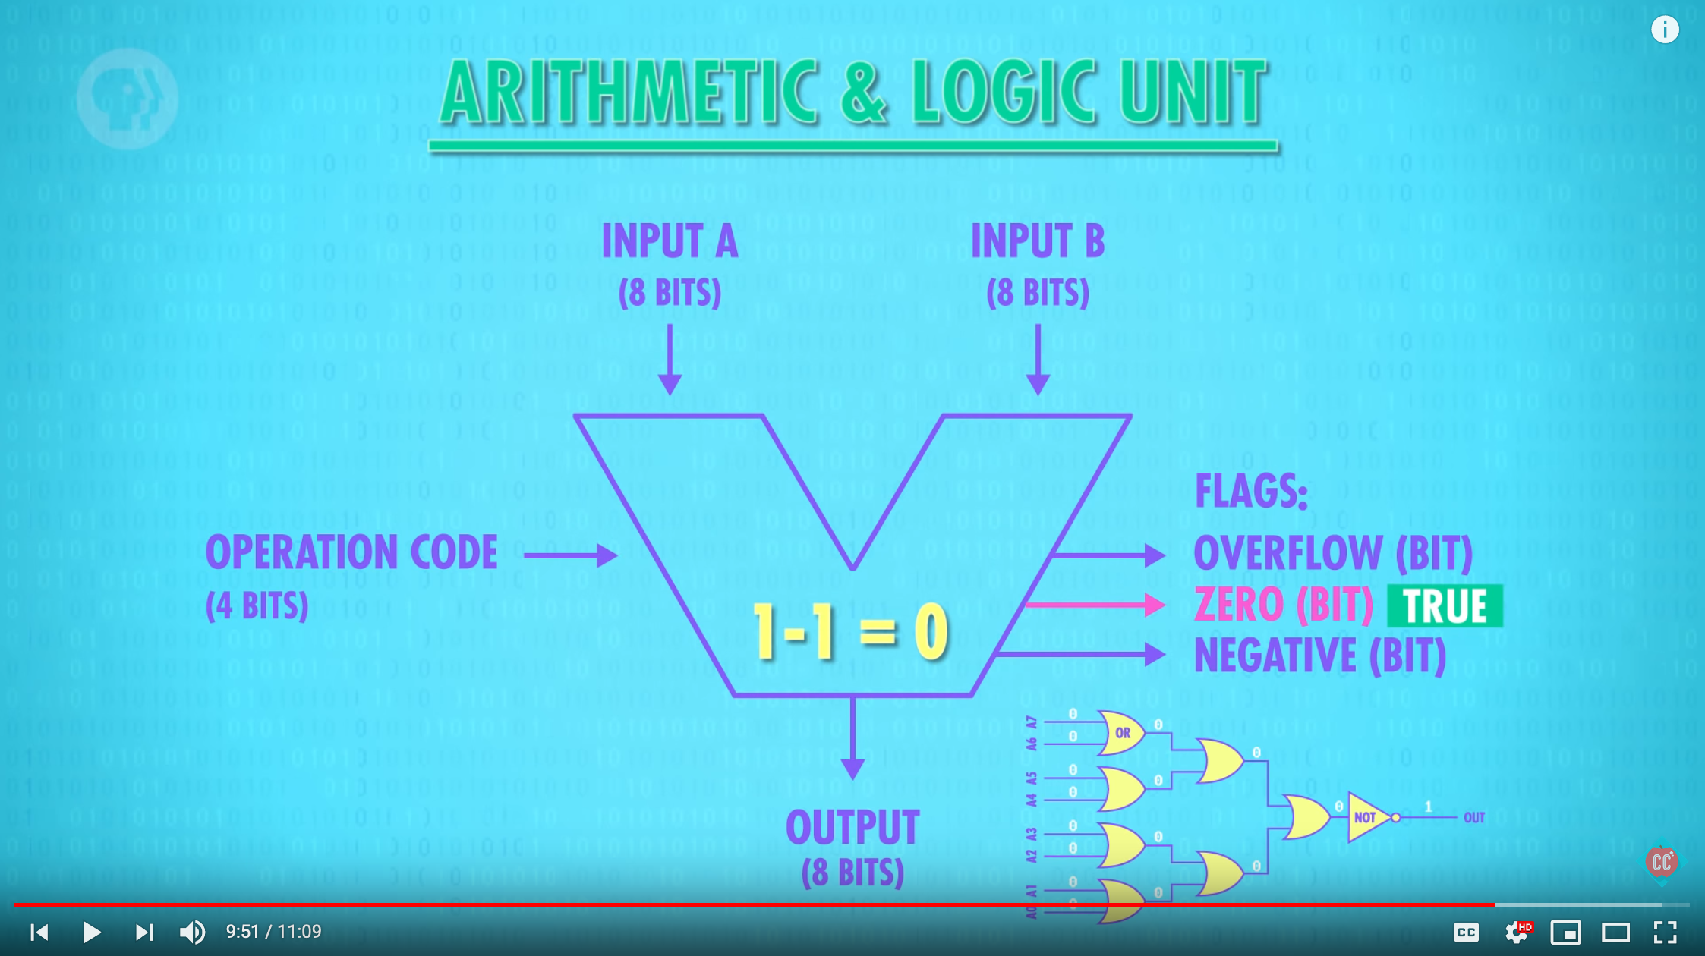
PBS Series: Crash Course on Computer Science
https://youtu.be/1I5ZMmrOfnA

Slide 22
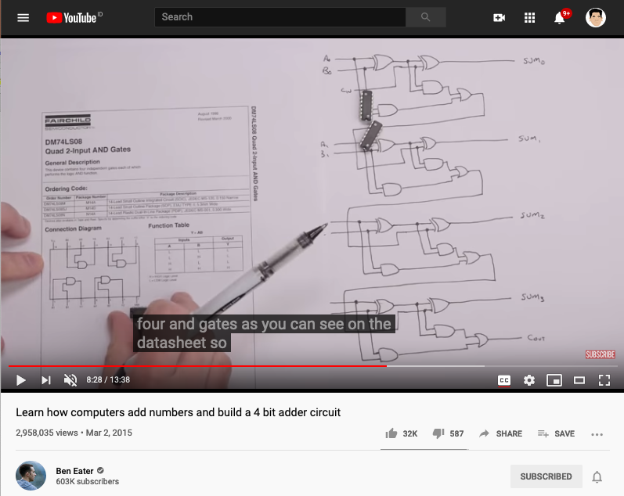
Adder implemented in Logic Gates
https://youtu.be/wvJc9CZcvBc

Slide 23
Main Ideas on Week 2 Project
Hack Computer uses a 16 bit Architecture (1 bit for Sign)
Number ranges from (- 32768 to 32768)
Subtraction is accomplished through adding “complement value”
A Full Adder is composed of two Half Adders (Carry bit)
ALU is purely combinatorial, no memory

Slide 24
Counting systems
quantity decimal binary 3-bit register
0 0 000
 1 1 001
 2 10 010
 3 11 011
 4 100 100
 5 101 101
 6 110 110
 7 111 111
 8 1000 overflow
 9 1001 overflow
 10 1010 overflow

Slide 25
Rationale

Slide 26
Binary addition
Assuming a 4-bit system:
0 0 0 1
1 0 0 1
0 1 0 1
0 1 1 1 0
1 1 1 1
1 0 1 1
0 1 1 1
1 0 0 1 0
+
+
no overflow
overflow
Algorithm: exactly the same as in decimal addition
Overflow (MSB carry) has to be dealt with.

Slide 27
Representing negative numbers (4-bit system)
0 0000
1 0001 1111 -1
2 0010 1110 -2
3 0011 1101 -3
4 0100 1100 -4
5 0101 1011 -5
6 0110 1010 -6
7 0111 1001 -7
1000 -8
The codes of all positive numbers begin with a “0”
The codes of all negative numbers begin with a “1“
To convert a number: leave all trailing 0’s and first 1 intact, and flip all the remaining bits
Example: 2 - 5 = 2 + (-5) = 0 0 1 0
+ 1 0 1 1
1 1 0 1 = -3

Slide 28
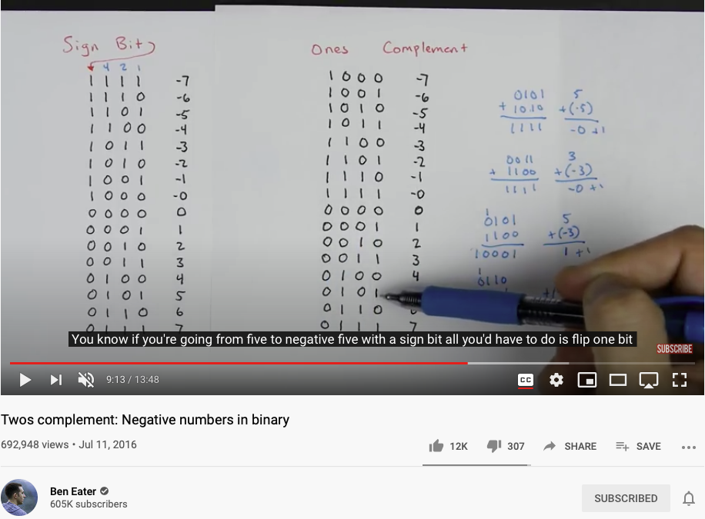
Twos Complement video
https://youtu.be/4qH4unVtJkE?t=553

Slide 29
Building an Adder chip
Adder: a chip designed to add two integers
Proposed implementation:
Half adder: designed to add 2 bits
Full adder: designed to add 3 bits
Adder: designed to add two n-bit numbers.

Slide 30
Half adder (designed to add 2 bits)
a b sum carry
0 0 0 0
0 1 1 0
1 0 1 0
1 1 0 1
Implementation: based on two gates that you’ve seen before.

Slide 31
Full adder (designed to add 3 bits)
a b c sum carry
0 0 0 0 0
0 0 1 1 0
0 1 0 1 0
0 1 1 0 1
1 0 0 1 0
1 0 1 0 1
1 1 0 0 1
1 1 1 1 1
Implementation: can be based on half-adder gates.

Slide 32
n-bit Adder (designed to add two 16-bit numbers)
+
... 1 0 1 1 a
… 0 0 1 0 b
… 1 1 0 1 out
Implementation: array of full-adder gates.

Slide 33
The ALU (of the Hack platform)
out(x, y, control bits) =
x+y, x-y, y–x,
0, 1, -1,
x, y, -x, -y,
x!, y!,
x+1, y+1, x-1, y-1,
x&y, x|y

Slide 34
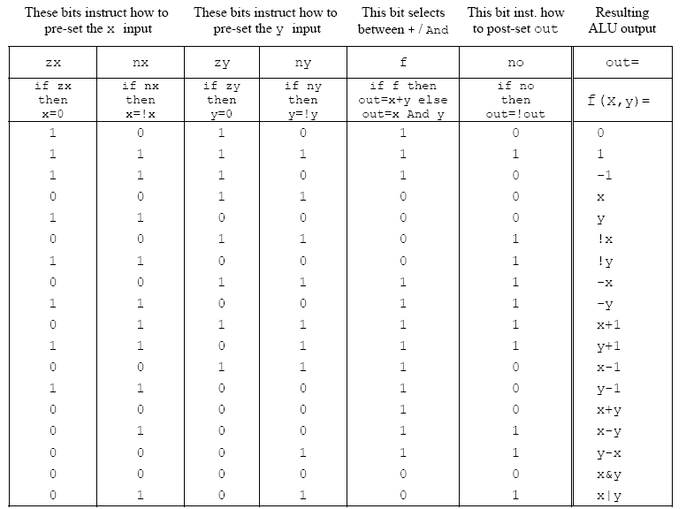
ALU logic (Hack platform)
Implementation: build a logic gate architecture that “executes” the control bit “instructions”: if zx==1 then set x to 0 (bit-wise), etc.

Slide 35
The ALU in the CPU context (a sneak preview of the Hack platform)
c1,c2, … ,c6
D
D register
a
out
A
ALU
A register
A/M
Mux
RAM
(selected register)
M

Slide 36
Perspective
Combinational logic
Our adder design is very basic: no parallelism
It pays to optimize adders
Our ALU is also very basic: no multiplication, no division
Where is the seat of more advanced math operations? a typical hardware/software tradeoff.

Slide 37
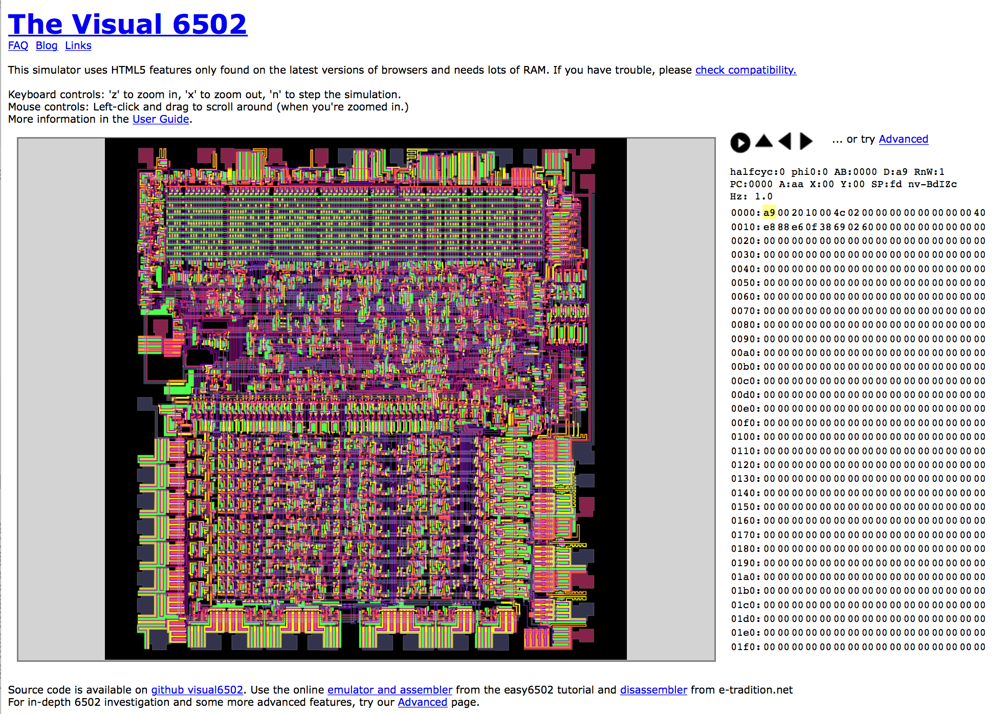
CPU is “Universal” (万用)
https://en.wikipedia.org/wiki/MOS_Technology_6502
http://www.visual6502.org/JSSim/index.html

Slide 38
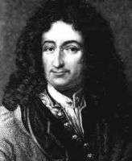
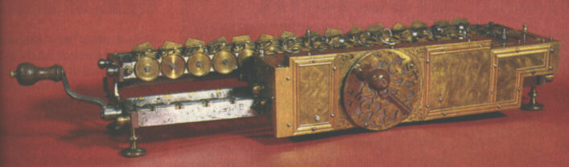
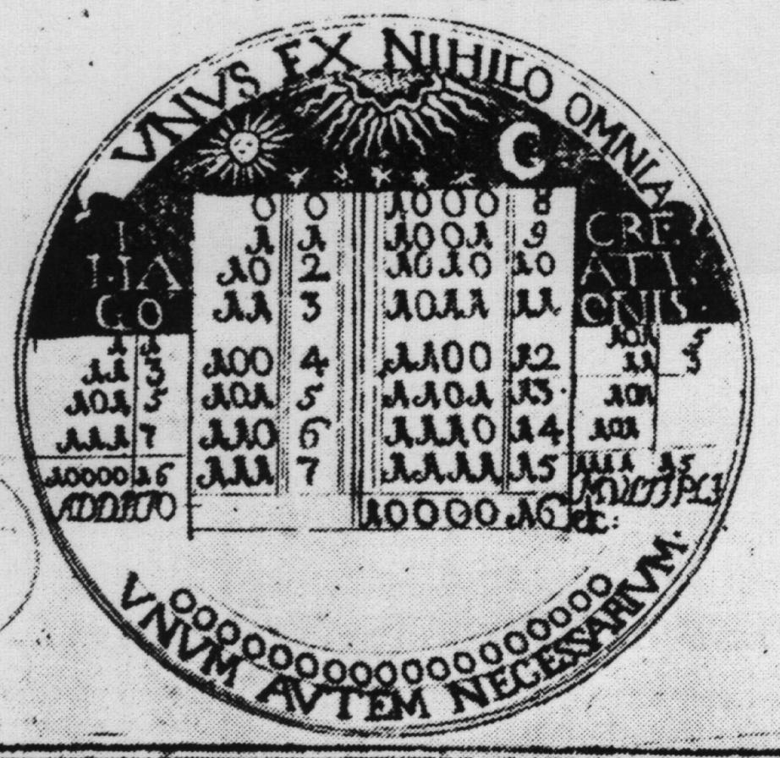
Historical end-note: Leibnitz (1646-1716)
“The binary system may be used in place of the decimal system; express all numbers by unity and by nothing”
1679: built a mechanical calculator (+, -, *, /)
CHALLENGE: “All who are occupied with the reading or writing of scientific literature have assuredly very often felt the want of a common scientific language, and regretted the great loss of time and trouble caused by the multiplicity of languages employed in scientific literature:
SOLUTION: “Characteristica Universalis”: a universal, formal, and decidable language of reasoning
The dream’s end: Turing and Gödel in 1930’s.
Leibniz’s medallion for the Duke of Brunswick

Slide 39
Gödel Numbering
Kurt Gödel’s picture from Wikipedia
In mathematical logic, a Gödel numbering is a function that assigns to each symbol and well-formed formula of some formal language a unique natural number, called its Gödel number. The concept was used by Kurt Gödel for the proof of his incompleteness theorems. (Gödel 1931)
https://en.wikipedia.org/wiki/G%C3%B6del_numbering#CITEREFG.C3.B6del1931

Slide 40
Cellular Automata
John Horton Conway
Picture from Wikipedia
Cellular Automaton picture from Wikipedia
A cellular automaton (pl. cellular automata, abbrev. CA) is a discrete model studied in computability theory, mathematics, physics, complexity science, theoretical biology and microstructure modeling. Cellular automata are also called cellular spaces, tessellation automata, homogeneous structures, cellular structures, tessellation structures, and iterative arrays.
https://en.wikipedia.org/wiki/Cellular_automaton

Slide 41
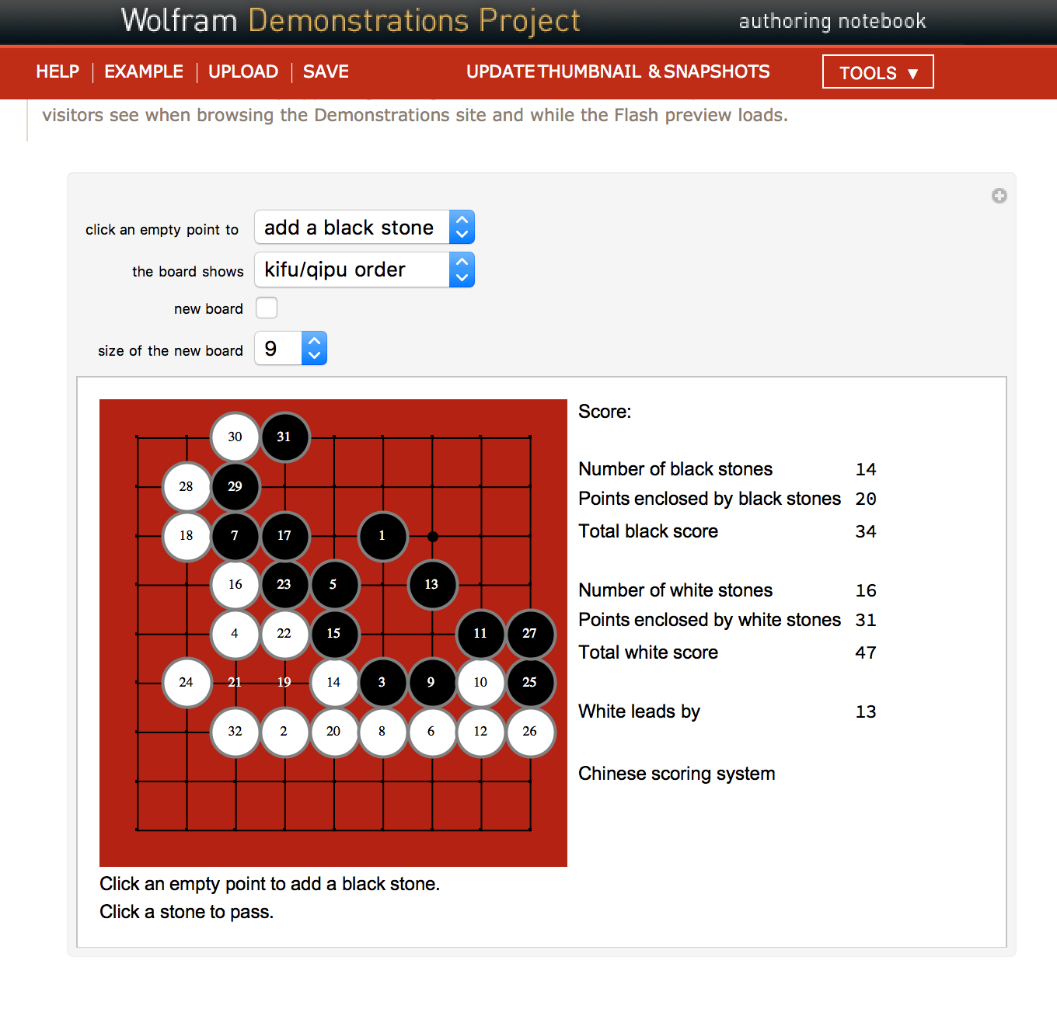
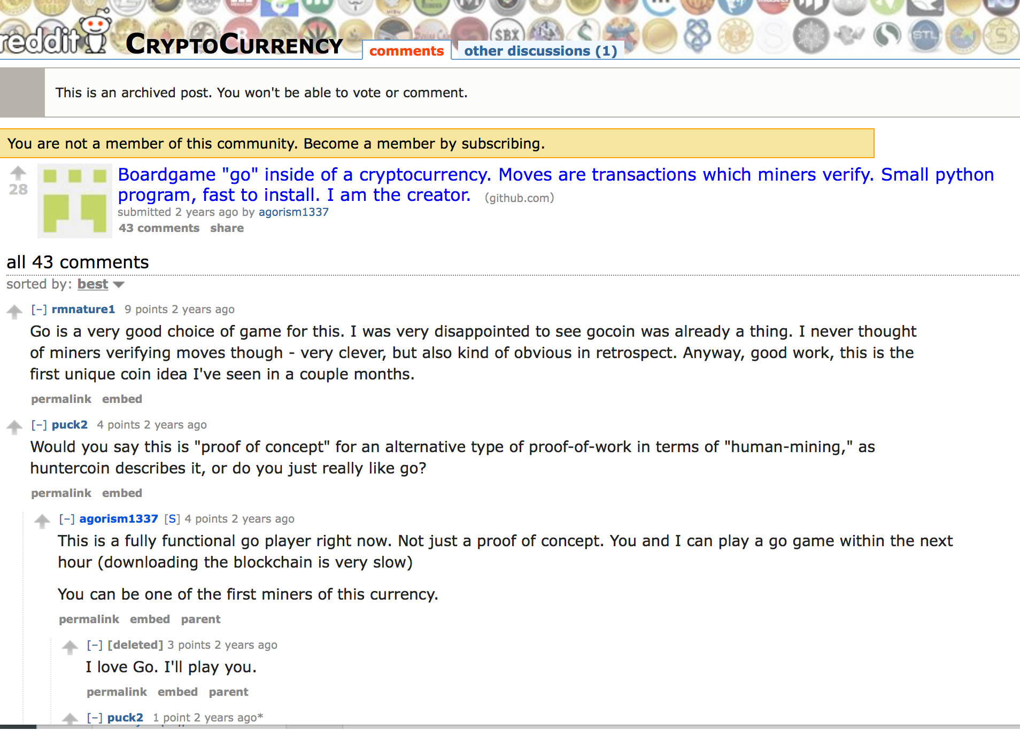
Application level: Go (by: José Luis Gómez-Muñoz)

Slide 42
Grading Policy
Your ability in identifying proper reference material
Learn from the Internet and Public Libraries
Use relevant data sources and provide argument for its validity
Your interpretation of content
Reflected in your documentation and implementation of the Go System
Grade Distribution
20% 课上参与， 40% 软件作业， 20% 学习报告，20% 教科书。

